Slide 1
DST INTERN PRESENTATION 2016
Ravi kiran Yadavalli | July 2016

Slide 2
Agenda

Slide 4
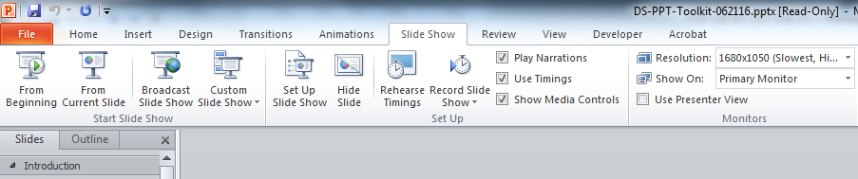
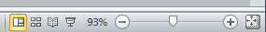
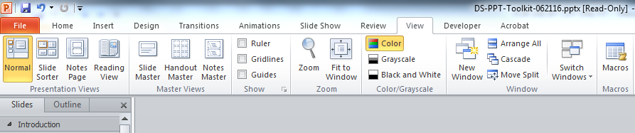
Viewing this Toolkit
Launch this PowerPoint in Slide Show mode in order to use the navigation tabs at the bottom of each page following the Table of Contents (slide 7).
View in Normal mode in order to cut and paste content into your own presentation.
OR
OR

Slide 5
3 Keys to a Great presentation
Tell a story
Begin by presenting the issue, challenge, or key finding
End by identifying the solution, providing support, and driving home the key point
Keep it simple
An abundance of images and graphics aren’t necessary to a compelling story
Summarize and refrain from overloading slides with copy – instead, reserve details for talking points
Present well
Rehearse and refine until you’re comfortable with your story’s flow

Slide 6
Using this Toolkit
Everything you need to know about the new DST PowerPoint is included in this deck. Slide Layouts, Font, Colors and Usage, Style Guides (for shapes, lines, charts, and SmartArt), Inserting Media (icons and images), building and converting PPT decks and links to valuable resources are all detailed in the following pages.
If you have any questions, or if you require additional resources, please reach out to your local Marketing Manager or visit DSTConnect’s Branding pages.

Slide 7
Table of Contents
01 Slide Layouts
02 Creating a New Presentation
03 Updating an Existing Presentation
04 Color Palette and Usage
05 Font
06 Shapes & Lines
07 Charts & Graphs
08 Smart Art
09 Media (Icons, Images)
10 Resources
Back
Return to Table of Contents

Slide 8
Slide Layouts
Back
Return to Table of Contents

Slide 9
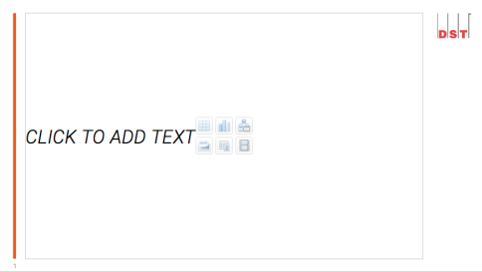
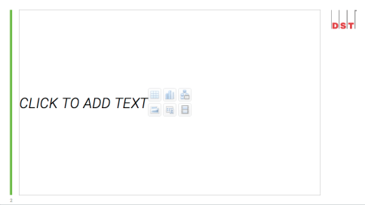
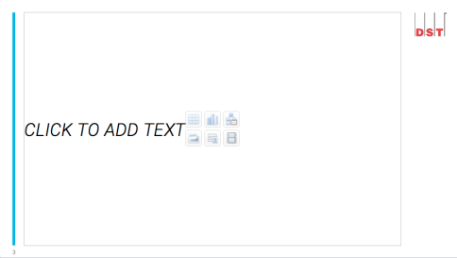
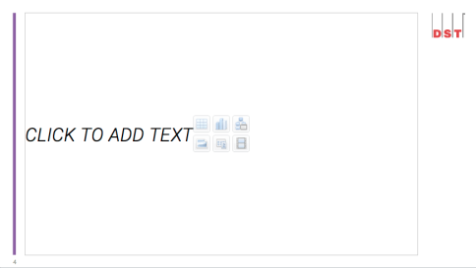
color coding
Four of the colors in the new color palette have been assigned a specific branding purpose within the enterprise:
Accordingly, PowerPoints for each of the above areas utilize slide layouts with their respective color. (Note the accent color on each vertical bar in the samples above). A full set of slide layouts is contained in the PowerPoint for each area. For simplicity, the Corporate layouts will continue to be used throughout this Toolkit.
Orange =
Corporate
Green =
Financial
Services
Blue =
Healthcare
Purple =
ALPS
Back
Return to Table of Contents

Slide 10
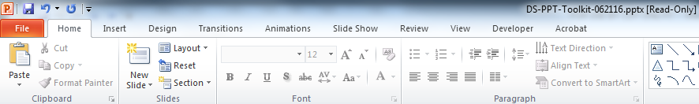
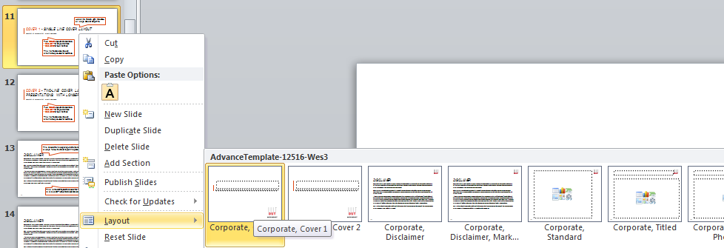
Applying Slide Layouts
The Slide Layout window can be accessed via the PPT Toolbar (Fig. 1) or by right-clicking a slide or thumbnail and selecting Layout from the flyout menu (Fig. 2).
1
2
Back
Return to Table of Contents

Slide 11
Cover 1 - Single line cover Layout
Headline: Roboto Light, Italic, black, all caps, sized at 28 points.
Name(s) of Presenter(s) | Month Day, YEAR
Two Cover Layouts are available:
Cover 1 for single line titles
Cover 2 for two line titles
The name and date line can alternatively be used for sub-titles.
Back
Return to Table of Contents

Slide 12
Cover 2 - Two-Line Cover Layout for presentations with longer titles
Name(s) of Presenter(s) | Month Day, YEAR
Two Cover Layouts are available:
Cover 1 for single line titles
Cover 2 for two line titles
The name and date line can alternatively be used for sub-titles.
Back
Return to Table of Contents

Slide 13
The Disclaimer is a legal requirement and will always follow the Cover layout in a presentation.
This is the DST Systems Disclaimer. There is also a DST Market Services Disclaimer.
Back
Return to Table of Contents

Slide 14
This is the DST Market Services Disclaimer.
Back
Return to Table of Contents

Slide 15
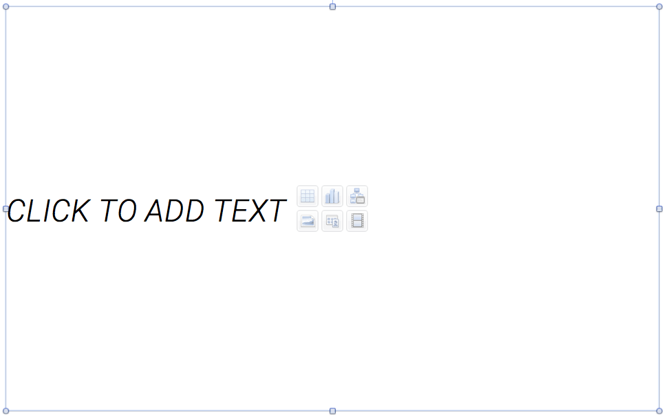

This is the Standard layout, designed to accommodate multiple needs – including text, charts, videos, images and more.
Text is vertically centered. Either begin typing in the text box…
or click the appropriate content button for charts, images, etc.
Back
Return to Table of Contents

Slide 16
The default for the Standard layout is Roboto Light, Italic, black, all caps, sized at 26 points.
Standard Layout – multi-purpose use
All of the text entered here can easily be auto-formatted to suit your needs. This new template feature is detailed in the coming slides.
For example – want a bulleted list?
Here’s a bullet
And a second-level bullet
And a third-level bullet
Back
Return to Table of Contents

Slide 17
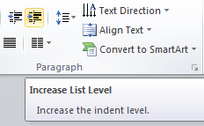
Default appearance
Select text and press Increase Indent once for body copy
Select text and press Increase Indent twice for first level bullets
Select text and press Increase Indent a third time for second level bullets
Select text and press Increase Indent a fourth time for third level bullets
Format content on the Standard layout by selecting/highlighting desired text and using the Increase Indent button in the Paragraph section of the toolbar.
Increase Indent button
Back
Return to Table of Contents

Slide 18
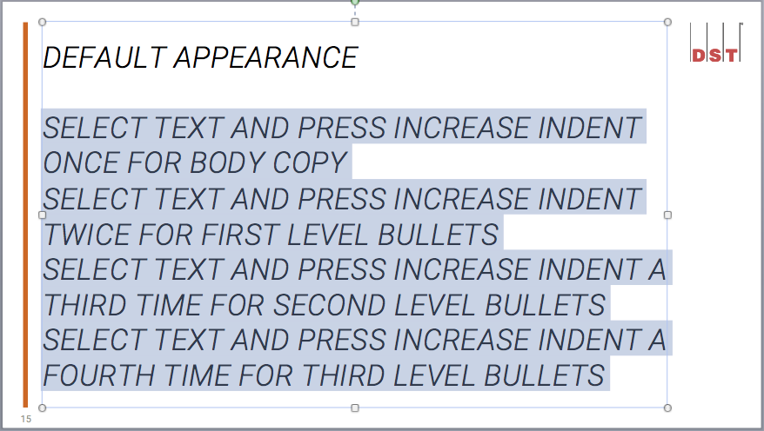
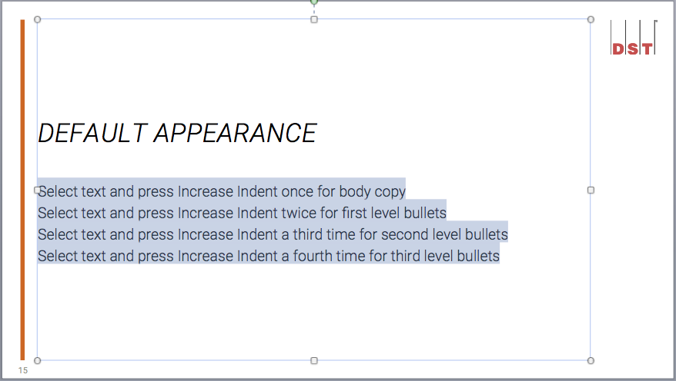
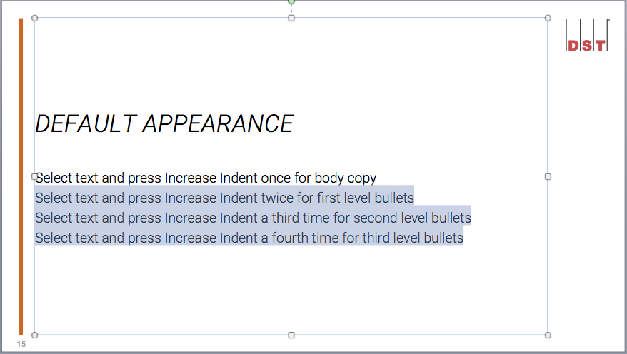
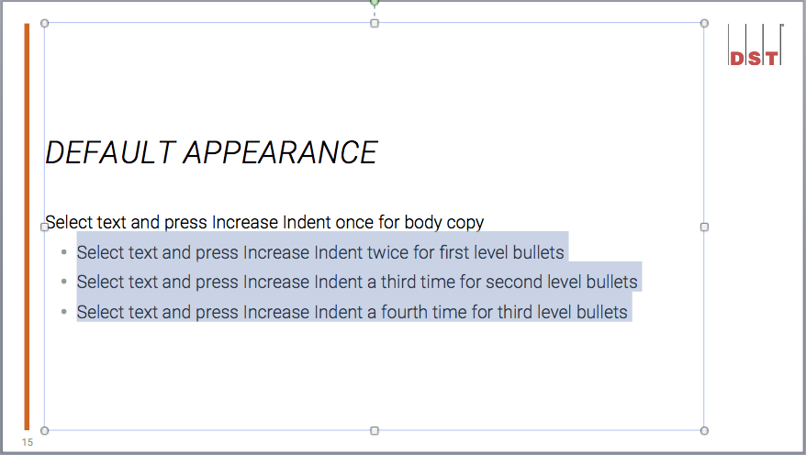
How it works: Increase indent function
1
2
Either type or paste (choose “Keep Text Only” if doing the latter) your content in the text box. Highlight all content you wish to change
With the desired content highlighted, click the Increase Indent button to produce body copy
If you wish to begin a bulleted list, change your highlighted selection to the copy to be bulleted
Click the Increase Indent button to produce a bulleted list
3
4
Back
Return to Table of Contents

Slide 19
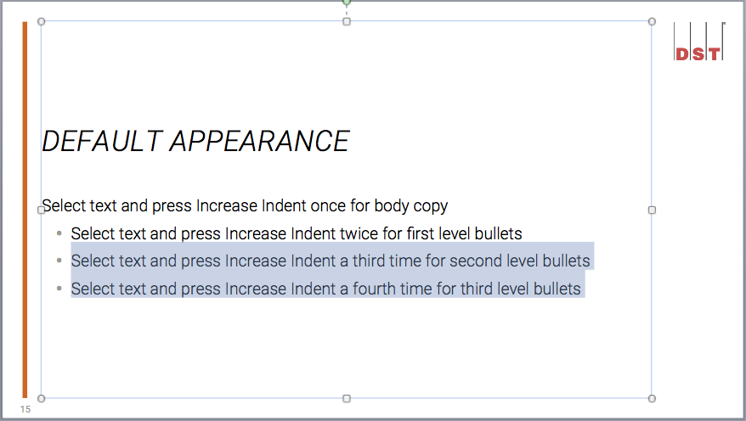
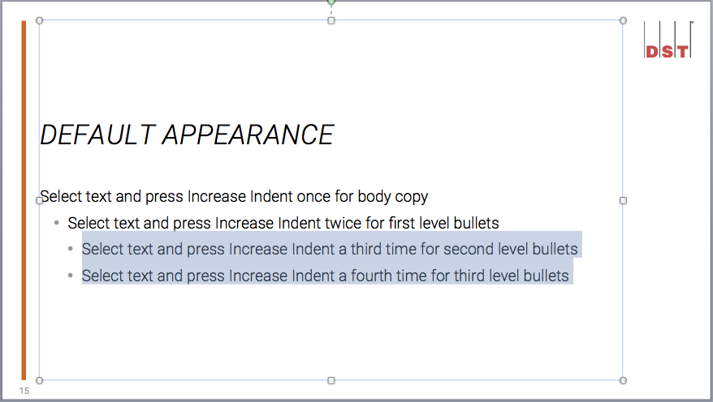
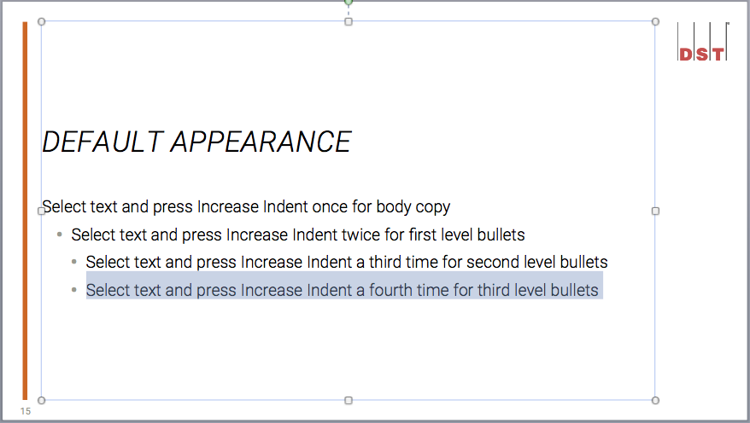
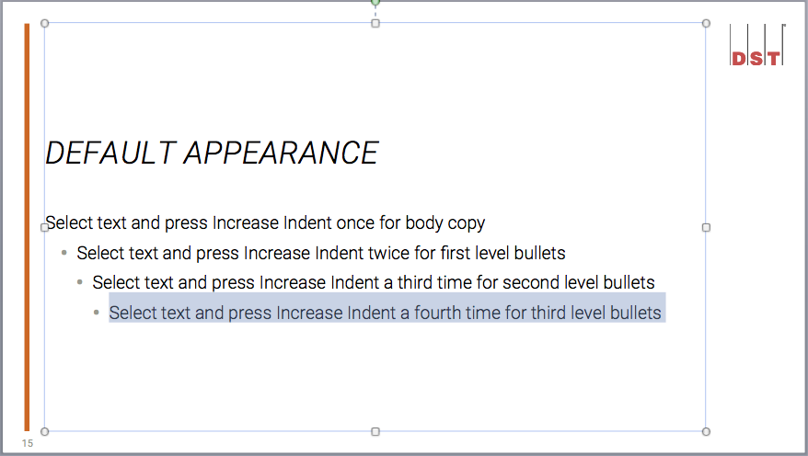
How it works: Increase indent function
5
6
If second-level bullets are desired, simply reselect the portion of text you wish to sub-bullet
Click the Increase Indent button and your second level bullets appear
If you have a need for third level bullets, simply select the text desired and...
Click the Increase Indent button to produce third-level bullets
7
8
Back
Return to Table of Contents

Slide 20
This Slide Changed My Life.
The Standard layout is also useful for chapter titles, segues, quotes and driving home specific points.
Back
Return to Table of Contents

Slide 21
TITLED Layout
The Titled layout provides a title bar (above) and this top-aligned space for additional copy.
As with the Standard layout, use the Increase Indent button to quickly apply styles to selected copy – such as this bullet point
Back
Return to Table of Contents

Slide 22

Titled PHOTO Slide with image space
The Titled Photo slide provides a title bar and a white space for adding images/graphics.
Back
Return to Table of Contents

Slide 23

When your presentation has a need for a full page image or graphic, use the Photo layout.
Back
Return to Table of Contents

Slide 24

This is the box 2 Layout
Use this slide for outlining or comparing two separate thoughts.
Graphics from the Icon library can also be added in the box, either above text or below, such as the following:
Use the Increase Indent button to take advantage of built-in formatting rules.
Simply select text and click the Increase Indent button for bullets
Back
Return to Table of Contents

Slide 25


This is the Box 3 Layout
Use this for outlining/comparing 3 different points.
Just like the Box 2 slide, icons from the Icon Library can be added to each box either below or above text.
Use the “Increase Indent” button for additional formatting.
Refer to Box 2 or Standard layout
Back
Return to Table of Contents

Slide 26
This is the Box 4 Layout
Useful for outlining/comparing four different points.
Use the “Increase Indent” button for more formatting.
Refer to Box 2 or Standard layout
Fourth point.
Third point.
Second point.
Supporting info or additional details can be recorded below each point.
Back
Return to Table of Contents

Slide 27

IMAGE LEFT Layout (With Text Right)
Use this slide when you wish to associate text points to an image or graphic.
Use the Increase Indent button for additional formatting.
Refer to Box 2
Or Standard layout
Back
Return to Table of Contents

Slide 28
IMAGE Right Layout (With Text LEFT)
Use this slide when you wish to associate text points to an image or graphic.
Use the Increase Indent button for additional formatting.
Refer to Box 2
Or Standard layout
Back
Return to Table of Contents

Slide 29
This is the Text 2 Layout
Use this layout for outlining or comparing two separate thoughts requiring more copy space than the Box 2 layout.
Use the Increase Indent button for additional formatting in each text box.
Refer to Box 2 layout
Or Standard layout
Back
Return to Table of Contents

Slide 30

This is the Out-Of-Brand Layout
Out-of-brand elements include
Diagrams, flow charts, images, Visio docs, etc., that were not created or sourced from DST Shared Services
Back
Return to Table of Contents

Slide 31
Creating a new Presentation
Back
Return to Table of Contents

Slide 32
Creating a New PRESENTATION
Download (from the DST Connect Branding space) and double click on the DS-PPT-Template-052616.potx to launch the new PowerPoint template.
If PowerPoint is already open – and you’ve already downloaded the new template – simply open the file via File>Open and navigate to the DS-PPT-Template-052616.potx file. If the file does not appear in its location, check to make sure “All Files” is selected in the file types field.
Back
Return to Table of Contents

Slide 33
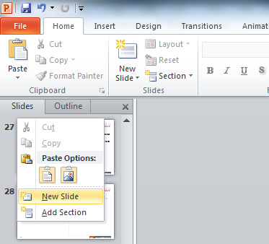
Creating a new Presentation
Insert slides by either right-clicking in the slide pane (when in Normal View) and selecting
New Slide or via Home>New Slide.
- or -
Right-click in the slide pane…
Then select New Slide from the flyout menu.
Back
Return to Table of Contents

Slide 34
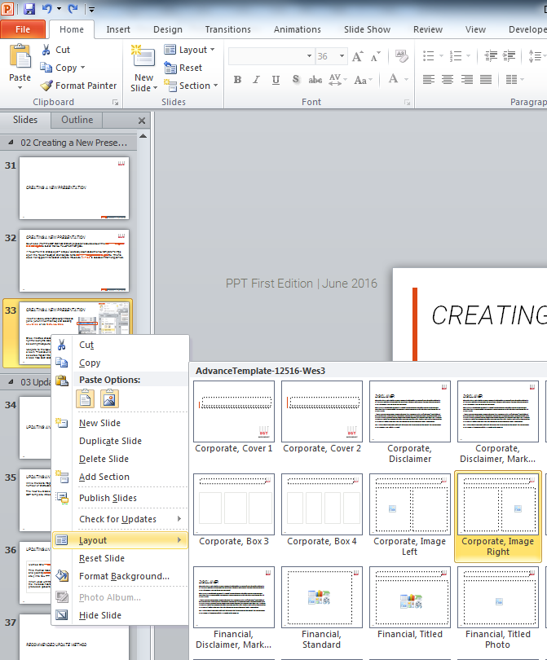
Creating a new Presentation
Once inserted, choose the desired layout by right-clicking the slide in the slide pane and selecting the layout option.
Navigate to the layout you want and simply click it. The slide will adjust to the layout selected. Repeat this process until all desired slides have been added.
Back
Return to Table of Contents

Slide 35
Updating an existing presentation
Back
Return to Table of Contents

Slide 36
Updating an existing presentation
While there’s no magic button to update an existing presentation to a new template, there are a number of shortcuts available to reduce the amount of effort required.
The next few slides offer best practices and tips for updating existing presentations to the new DST template. While some things may convert easily, others may require more attention.
Back
Return to Table of Contents

Slide 37
Updating an existing presentation
Method One ** Recommended **
This method relies on simply copying and pasting content (e.g. text, graphics, etc.) into new PPT slides.
When used with the built-in formatting of the Increase Indent button, this method produces quicker and cleaner results.
Method Two
Instead of copying and pasting content, this method copies and pastes whole slides into a new PPT deck.
While seemingly quick, this method ultimately requires much more formatting and cleanup effort.
Back
Return to Table of Contents

Slide 38
Recommended Update Method
Back
Return to Table of Contents

Slide 39
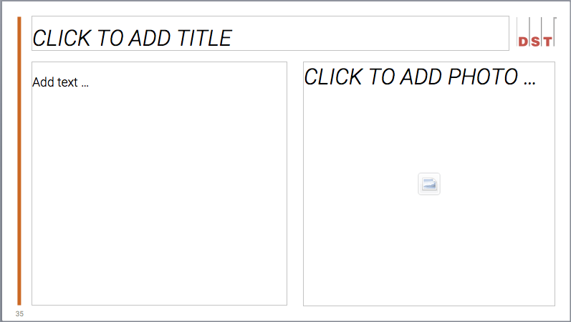
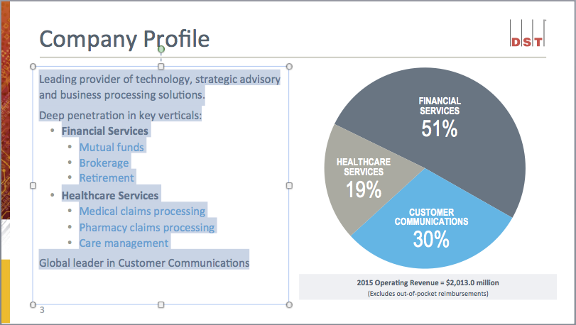
Recommended update method
Open both your existing presentation and a new DS-PPT-Template-052616.potx
On the new PPT, add the appropriate Cover and Disclaimer slides followed by a new blank slide. Select a layout (Fig.1) that best mimics the existing slide’s layout
Navigate to the existing slide and copy text from any single text box (Fig. 2)
1
2
Back
Return to Table of Contents

Slide 40
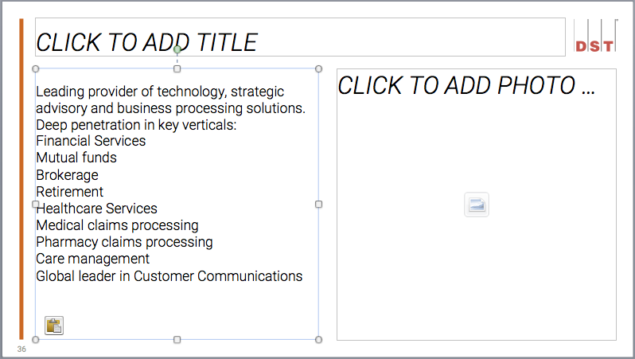
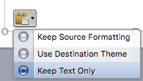
Recommended update method
Paste the copied text into the desired text box on the new slide (Fig. 3)
Important: Be sure to click on the fly-out and select “Keep Text Only” (Fig. 4). This ensures no old/invalid PPT formatting will be carried over to your new slide
Note: “Use Destination Theme” does not apply the correct paragraph style (but should be used when moving shapes, graphs, and SmartArt to the new PPT). For more information on formatting these items, revisit the Table of Contents
3
4
Back
Return to Table of Contents

Slide 41
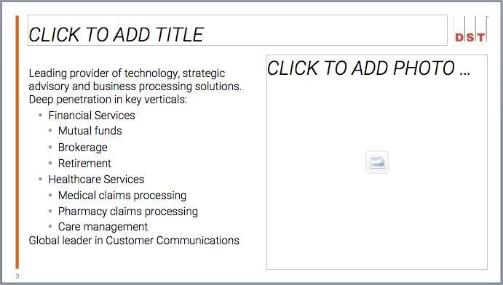
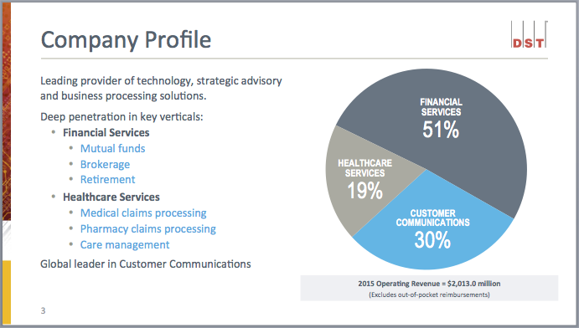
Recommended update method
In some cases, the pasted content will be fine as-is. In other cases (e.g. bullets) you will want to use the built-in styles available via the Increase Indent button
In our example we need both first and second level bullets, and we’ll walk through how this is easily achieved in the next two slides
New Slide
Original Slide
Back
Return to Table of Contents

Slide 42
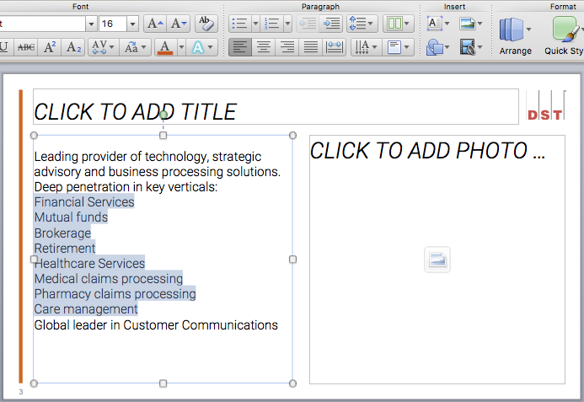
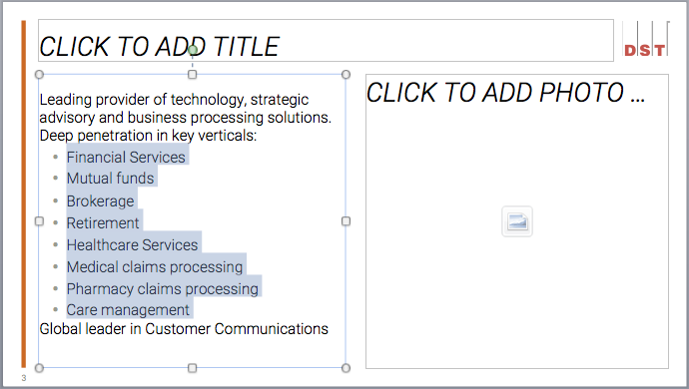
Recommended update method
First, select the text to format and click the Increase Indent button (Fig. 5)
The first-level bullet style will be applied (Fig. 6)
5
6
Back
Return to Table of Contents

Slide 43
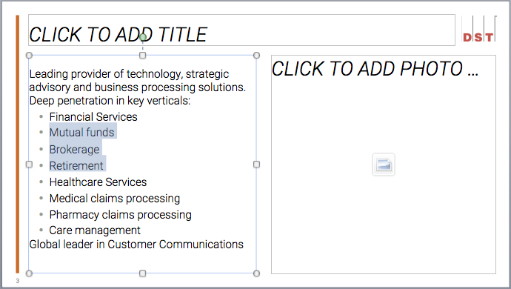
Recommended update method
Next, select the text to format as second-level bullets and click the Increase Indent button again (Fig. 7). Repeat for any additional copy
The second-level bullet style will be applied (Fig. 8)
7
8
Back
Return to Table of Contents

Slide 44
Recommended update method
Type the slide title/header into the appropriate field
Copy and paste any additional elements
Check the respective sections for shapes, callouts, charts & graphs, etc. to see what the current brand standards allow. Some items can be copied and pasted using the destination theme, but others will need to be recreated or adjusted
7
8
Back
Return to Table of Contents

Slide 45
Recommended update method
Continuing with our example, the chart from the existing slide can be carried over, but will require a few tweaks before its 100% in brand
Check out the Charts and Graphs section to pickup on this slide modification
7
8
Back
Return to Table of Contents

Slide 46
Alternative Update Method
** Not Recommended **
Back
Return to Table of Contents

Slide 47
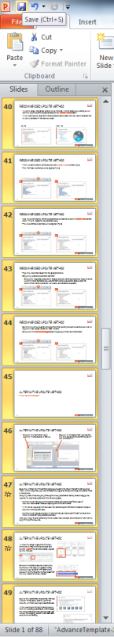
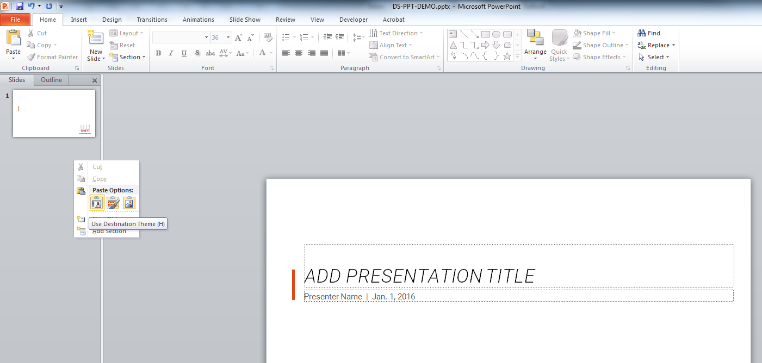
Alternative Update Method
Click on any thumbnail in your existing file and Select All (Ctrl+A)
Paste into the thumbnail pane in the New PPT
Be sure to select “Use Destination Theme” when pasting
Back
Return to Table of Contents

Slide 48
Alternative Update Method
Save the untitled file in the same folder as your existing file. Give it the same name, but put “NEW” at the beginning (e.g., NEW BPS Overview.pptx) so that you can keep the existing file as a reference.
Keeping both windows open, go through the new presentation slide by slide and apply new layouts to each slide (detailed on the following page).
Right-click on the slide or in the slide thumbnail pane and select “Slide Layout.” You can also access the Slide Layout pane in the home ribbon
In the Slide Layout pane, mouse over the desired layout thumbnail and select the layout desired for the current slide
Right-click on the actual slide or in the thumbnail pane and select “Reset” to ensure that titles and content are positioned correctly
After you have finished converting the file, delete the old version and remove the “NEW” at the beginning of the new one.
Back
Return to Table of Contents
Notes:
48

Slide 49
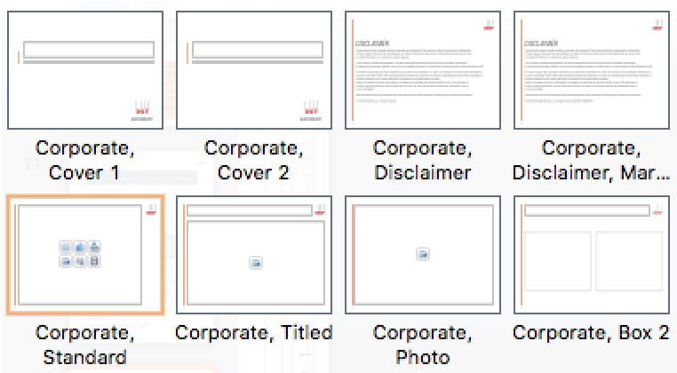
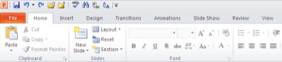
Alternative Update Method
In order to assign a layout from the new template, simply right click the slide and select Layout. You can also access Layouts via the Home Toolbar
Choose the desired layout by clicking the thumbnail. The slide will update and may produce odd results as PPT attempts to account for the movement of text boxes from the old master to the new master.
Back
Return to Table of Contents
Notes:
49

Slide 50
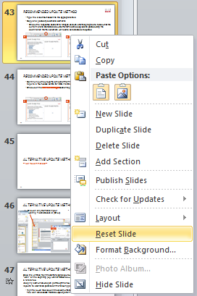
Alternative Update Method
After choosing a desired layout, right-click the slide and Reset it.
Back
Return to Table of Contents
Notes:
50

Slide 51


Alternative Update Method
Due to the constraints of switching from one Master Template to another, your initial results will most likely require additional work.
In the example on the right, the top slide is from an existing presentation. After following the steps detailed on the previous page, you’ll notice the resulting bottom slide needs some additional formatting.
Back
Return to Table of Contents

Slide 52

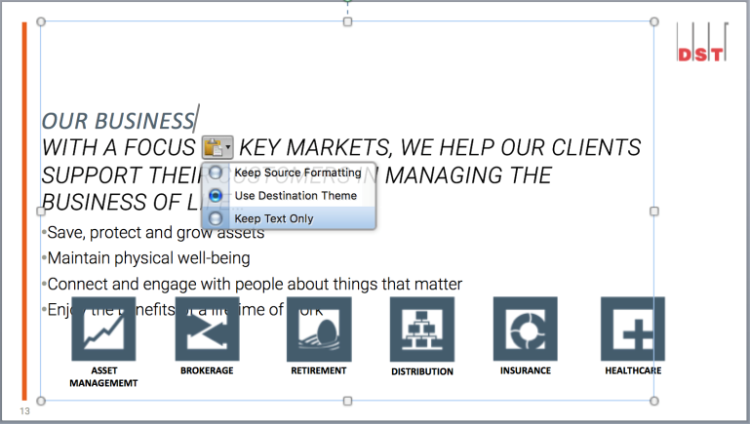
Alternative Update Method
Since the Standard slide utilizes a single text box, the “Our Business” component was reproduced as a new, separate text box.
In instances such as this, simply select the text in question and Cut. Then, using your cursor to access the main text box, paste the content to the desired location. Be sure to select the paste option “Keep Text Only” so as to maintain the new brand formatting.
As “Our Business” was the header, it was pasted at the top of the body content.
Back
Return to Table of Contents
Notes:
52

Slide 53
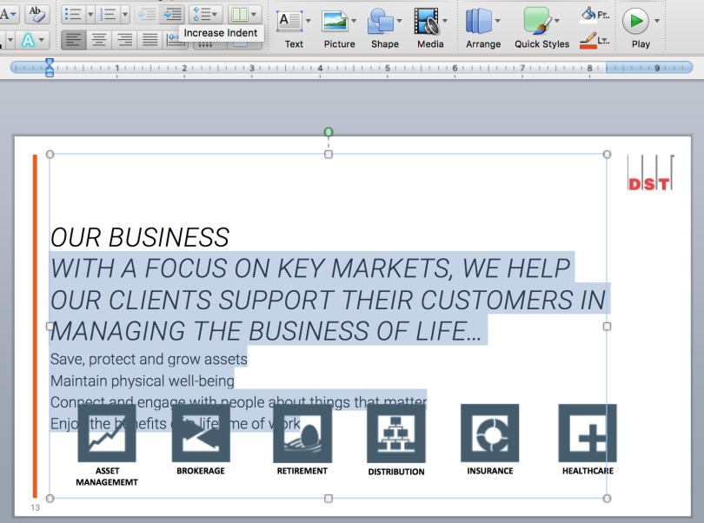
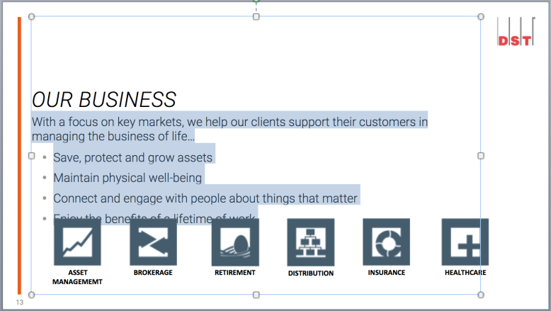
Alternative Update Method
Once the copy is in place, you can proceed with formatting the rest of the slide.
In this case, we want to set the body copy apart from the slide title, so after highlighting the body copy under “Our Business,” simply click the Increase Indent button in the Paragraph window to automatically format.
In order to shift the copy above the graphics, simply hit the Enter/Return key following the last line of the body copy.
Back
Return to Table of Contents
Notes:
53

Slide 54
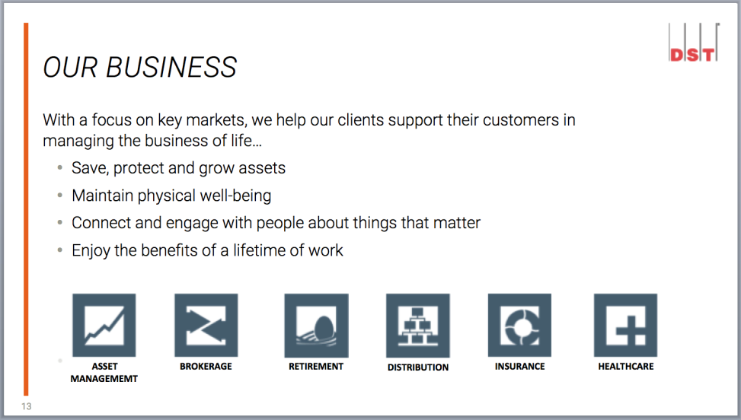
Alternative Update Method
While the slide content may have successfully been converted, some carried-over elements may no longer be in brand – such as the icons at the bottom of this particular slide.
Be sure to check out the Brand Standards guide (also on the DST Connect Branding space) for additional information regarding icons and image styles. A library has been developed for both and is available on the same DST Connect Branding space.
Copied icons, graphics, and images may no longer be in brand. Check the Brand Standards guide for clarification.
Back
Return to Table of Contents

Slide 55
Color Palette and usage
Back
Return to Table of Contents
Notes:
55

Slide 56
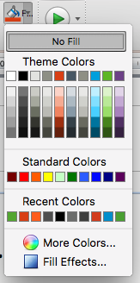
Color Palette and Usage
Orange
R221, G72, B20
Green
R93, G176, B56
Blue
R0, G169, B224
DST Corporate
Charts/Graphs
Text Callouts*
Financial Services
Charts/Graphs
Text Callouts*
Healthcare
Charts/Graphs
Text Callouts*
Use These
Purple
R120, G74, B146
Black
R0, G0, B0
Graphite
R81, G98, B111
ALPS Advisors
Charts/Graphs
Text Callouts*
Default Text
Charts/Graphs
Charts/Graphs
Not These
* Text Callout colors can only be used on their respective PPTs. Continue to next slide for additional information.
Back
Return to Table of Contents

Slide 57
Text and callout Text colors
The standard text color is Black.
Orange, Green, Blue and Purple can be used for Callouts in their respective presentations. Grey is used for footnotes and citing sources.
For example:
Corporate themed presentations (such as this) can use Orange as a Callout color
Financial Services presentations can use Green as a Callout color
Healthcare decks can use Blue Callouts
ALPS Advisors presentations can use Purple as a Callout color
Footnotes/Citing Sources
Callout Color Options
Default text color
Back
Return to Table of Contents

Slide 58
Font
Back
Return to Table of Contents

Slide 59
Roboto Light
The DST PowerPoint theme uses the font Roboto Light. All type in your presentations – whether it’s part of a graphic, table, chart/graph, or SmartArt – should be set in Roboto Light.
Back
Return to Table of Contents

Slide 60
Font Sizing
Title font size (above) defaults to 26 pt. There is no maximum/minimum pt. size.
Body copy, such as this, is set to 16 pt. but can be reduced depending on content and use. Try to avoid reducing the font simply to accommodate more text – instead, summarize the content with less words and/or use the additional information as talking points.
Back
Return to Table of Contents

Slide 61
Roboto Light And Converted Slides
If converting a presentation from the old theme to the new one, you need to review all tables, charts, and graphs to ensure the correct font is being used.
The quickest way to update text boxes on any given slide is to Select All (Edit>Select All) and then choose or type Roboto Light in the font box.
For charts, graphs and tables, simply select the chart, graph, or table and then choose or type Roboto Light in the font box. Examples follow on the next slide.
Back
Return to Table of Contents

Slide 62
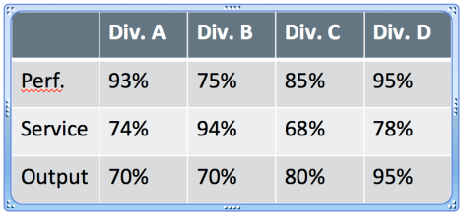
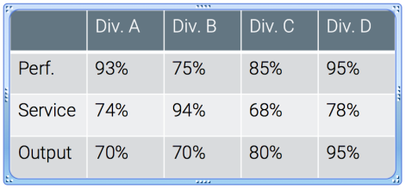
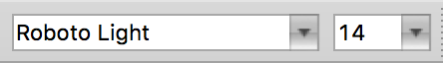
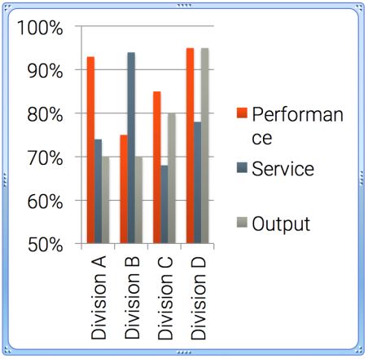
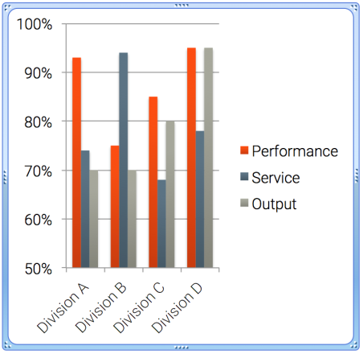
Updating table, chart or graph fonts
Simply select the item (table, chart, or graph) then type or choose Roboto Light from the font box
Selected Original
Type or choose Roboto Light from font box; Reduce or enlarge font as needed
In-Brand, End Result
Back
Return to Table of Contents

Slide 63
Shapes and lines
Back
Return to Table of Contents

Slide 64
Shapes and text callouts
Clean and simple designs are to be used for shapes and callouts: squares and rectangles with solid colors and no effects.
Correct
Here is a text callout
Incorrect
Here is a text callout
Here is a text callout
Here is a text callout
Here is a text callout
Here is a text callout
Here is a text callout
Bevels
Gradient fills
Rounded corners
Glow
Soft edges
Drop shadow
Back
Return to Table of Contents

Slide 65
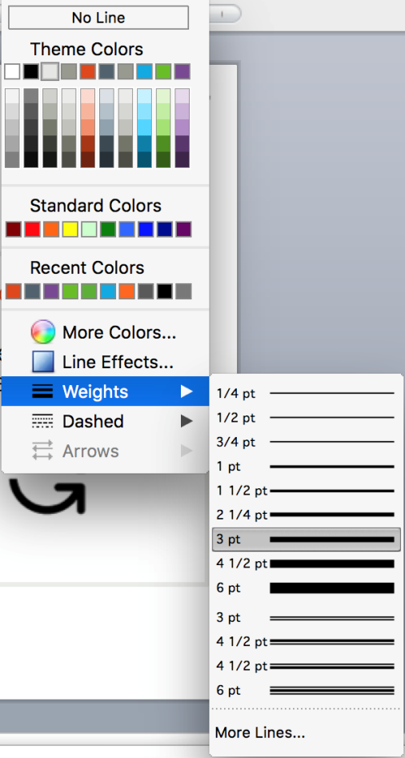
Alternate text callouts
If preferred, you may create text callouts with no fill color and a light grey outline from 1 pt. to 3 pt. in weight.
Grey
Correct
Here is a text callout
Anything from
1 pt. to 3 pt.
weight
Here is a text callout
Back
Return to Table of Contents

Slide 66
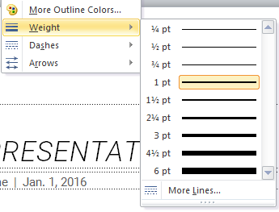
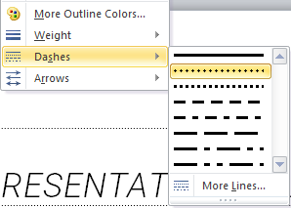
Lines
The use of lines as either connectors or separators can help clarify displayed information.
Lines can be solid, dashed or dotted and typically grey in color. Arrows can also sparingly use the PPT theme’s branding color to call out particular pieces of information (such as the orange arrows used throughout this toolkit).
Any of the lighter Greys
Anything from ½ pt. to 1 ½ pt. weight
Solid, dotted, or dashed
Examples:
Back
Return to Table of Contents

Slide 67
Lines – Sample Use
Regulations
(e.g., Regulatory Notice 15-02)
Maintenance
Progress
Modernization
Rival Transformation
(e.g., rebranding, repositioning)
Category A
Back
Return to Table of Contents

Slide 68
Charts & Graphs
Back
Return to Table of Contents

Slide 69
Recommended charts
Doughnut
Column
Bar
2-D Line
Back
Return to Table of Contents

Slide 70
Doughnut Charts
New this year is the featured use of doughnut charts.
Doughnut charts are perfect for highlighting specific subsets/percentages of information.
For example:
10%
20%
70%
Category A
Category B
Category C
Back
Return to Table of Contents

Slide 71
Doughnut Charts
When using doughnut charts to highlight a specific percentage, that slice should be colored in the appropriate branding highlight color (e.g., orange here for Corporate). A text box centered in the middle of the doughnut should then be used to indicate the percentage.
10%
20%
70%
Category A
Category B
Category C
Back
Return to Table of Contents

Slide 72
Doughnut Charts
When using the doughnut chart to convey multiple percentages, a legend should be incorporated – detailing each color-coded slice’s value.
Legends can be added from the Chart Layout dialogue box.
Back
Return to Table of Contents

Slide 73
Column charts
Any one of the 2D Column charts can be used, depending on need.
Use These:
Clustered Columns
Stacked Columns
100% Stacked Columns
Back
Return to Table of Contents

Slide 74
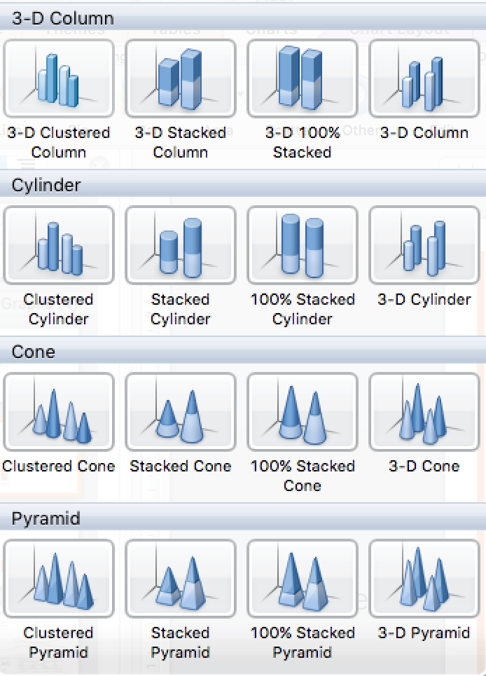
Column charts
3D, Cylinder, Cone, and Pyramid are not to be used.
Not These:
Back
Return to Table of Contents

Slide 75
Bar charts
Any one of the 2D Bar charts can be used, depending on need.
Use These:
Clustered Bar
Stacked Bar
100% Stacked Bar
Back
Return to Table of Contents

Slide 76
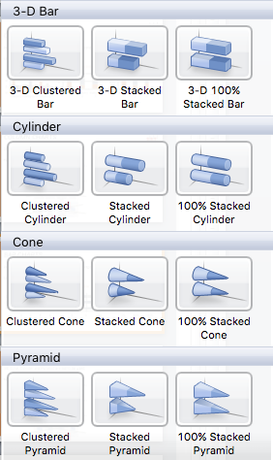
Bar charts
3D, Cylinder, Cone, and Pyramid are not to be used.
Not These:
Back
Return to Table of Contents

Slide 77
Line charts
Any one of the 2D Line charts can be used, depending on need.
Use These:
Line
Stacked Line
100% Stacked Line
Marked Line
Stacked Marked Line
100% Stacked Marked
Back
Return to Table of Contents

Slide 78

Line charts
3D is not to be used.
Not This:
Back
Return to Table of Contents

Slide 79

Chart Style
All charts should use the style listed in the top row, second column of Chart Styles.
Use This
Back
Return to Table of Contents

Slide 80
Smart Art
Back
Return to Table of Contents

Slide 81
Smart art
When using SmartArt, the same style guides for shapes, lines, and fonts apply. Be sure to adjust the shapes after your initial SmartArt build to bring the piece in-brand.
Default:
Adjusted:
Goal
Social Leverage
Financial Support
Competitive Pricing
Goal
Social Leverage
Financial Support
Competitive Pricing
Shape outlines removed, font changed to Roboto Light.
Back
Return to Table of Contents

Slide 82
Smart art
When using SmartArt, the same style guides for shapes, lines, and fonts apply. Be sure to adjust the shapes after your initial SmartArt build to bring the piece in-brand.
Research
Development
Sales
Research
Development
Sales
Default:
Adjusted:
Graphic Style changed to “Simple,” Color scheme changed to “colorful,” shape outlines removed, font changed to Roboto Light.
Back
Return to Table of Contents

Slide 83
Media
Icons and Images
Back
Return to Table of Contents

Slide 84



Images
An image library has been created and is available on the DST Connect Branding space.
Consult with a Marketing Manager if you need an image outside of what’s available in the library. When looking for images to convey your thought(s), focus on images featuring real-looking people in a real-life setting. The photo should have a light or diffused background and a look similar to the images in the library.
Examples:
Avoid clip art and non-brand graphics.
Back
Return to Table of Contents

Slide 85




icons
An icon library has been developed and is available on the DST Connect Branding space.
Examples:
Back
Return to Table of Contents

Slide 86
















Icon Use
When you have a concept you would like to depict, consult the icon library for possible options.
Concept: Try this: Instead of this: Concept: Try this: Instead of this:
Upward, Trending,
Increased Return,
Progress, Etc.
Global Strategy, Reach, Objective, Scope, Etc.
Analytics, Insights, Research, Financial Highlights, Etc.
Targeted, Aim, Goals, Purpose, On Point, Etc.
Engineering, Tools, Service, Settings, Maintenance, Etc.
Intelligence, Smart, Thoughts, Logic, Knowledge, Etc.
Security, Verified, Protection, Risk, Compliance, Etc.
Growth, Organic, Development,
Back
Return to Table of Contents

Slide 87








Icon Use
In many cases, an icon may not even be necessary. Simple expressions, descriptors and concepts (e.g. Welcome, Agenda, Meeting, Thank You, etc.) do not need an accompanying image and should instead use the Standard layout with a simple type treatment.
Back
Return to Table of Contents

Slide 88
Resources
Back
Return to Table of Contents

Slide 89
Links to Additional brand resources
Need to update with links/names once complete
Include:
DST Connect info
Brand Book/Guide
Videos
Etc.
Back
Return to Table of Contents

Slide 90
Thank you
If you have questions, suggestions, or other feedback, please let us know.
Contact info… HERE
Back
Return to Table of Contents

